Slide 1


October 14, 2021

Slide 2

BLOCKCHAIN  DATA SCIENCE  IOT

Slide 3

intro
About BONbLOC
  Bb team on call today
Agenda
  Our learning
  Our successes
  Open forum

Slide 4
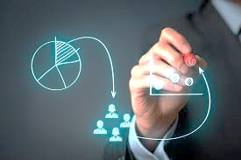
we are learning
GTM/Customer facing projects
  Commercial
  Government/Public Sector
  Socio-economic
Apps
APIs
BigData
p2p
remoTrak
IOT Library/Engine
Trace2e Library/Engine
Off chain core
On chain core (Fabric)
Notes:
Since 2018
Industry applications

Slide 5
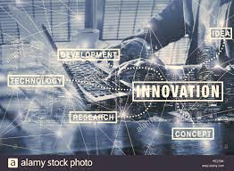
..and learning
Internal projects
  Cross framework integration, interaction*
  Administration UI for Fabric*
  Common API framework for Fabric-External integration*
  Automated Channel/Network setup & configuration based on business transaction (data)
Notes:
*
Managing CA Certificates
Register Enroll and Revoke identities
Creating the single org and multi org network
Adding Orderers and Peers to the network
Channel creation

Slide 6

so far so good
#
nalu
5
e2e align (-)
IOT, Fabric, ML, Presto (-)
munu
2
3
e2e status
IOT, Fabric, API
rendu
onru
e2e tracking
Fabric
Presto (-)
edgeData SaaS
IOT, Fabric, ML, Presto (-)
Notes:
3 types of edge data clusters
2 solutions (you are able to track, now what?)
5 industries (wismo is just the beginning)
# – holy grail?

Slide 7
ama & thank You
For more information, please contact:
Berta Fuentes
berta.fuentes@bonbloc.com
www.bonbloc.com

